Slide 1
PREDICTING traffic accident severity
Applied Data Science Capstone

Slide 2
TRAFFIC ACCIDENTS
Cause of 1.35 million deaths globally in 2016.
Main cause of death among those aged 15–29 years.
Predicted to become the 7th leading cause of death by 2030.
Predicting the accident severity in advance could be used to send the exact required staff
and equipment to the place of the accident, thus saving a significant amount of lives each year.
Last the road safety should be a prior interest for governments, local authorities and private companies investing in technologies that can help reduce accidents and improve overall driver safety.

Slide 3
Data
All the recorded accidents in France from 2005 to 2016, both years included. Initial dataset from the Kaggle.
Pre-selcted features on my GitHub, here In total 49 features, 839,985 rows in the Kaggle dataset Redundant and not relevant features were dropped 29 features pre-selected On the data cleaning missing values and outliers were replaced.

Slide 4
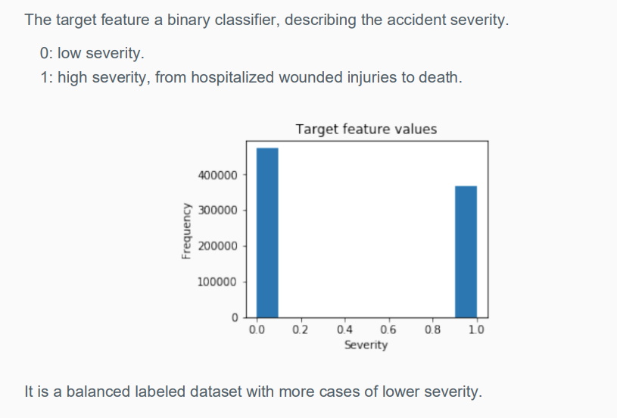
EDA-Target

Slide 5
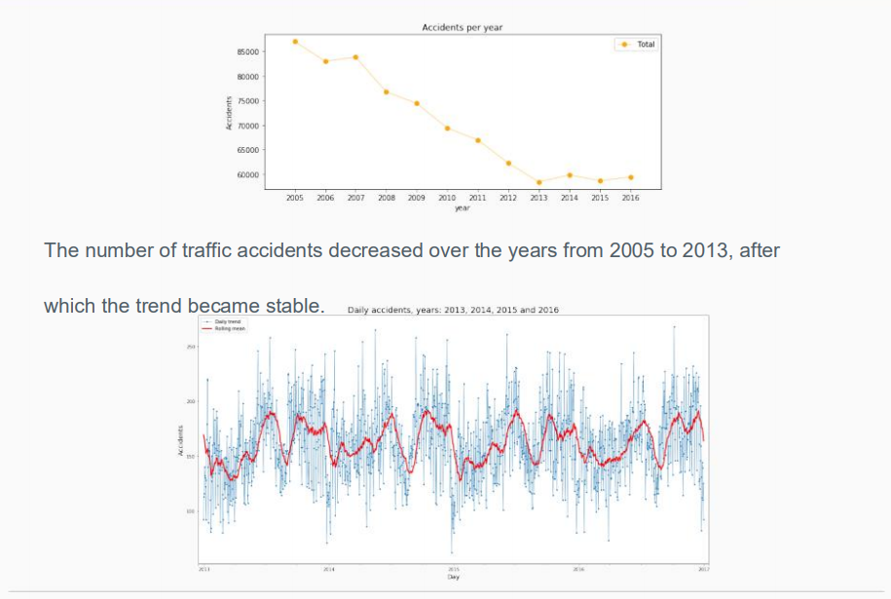
EDA-Seasonality

Slide 6
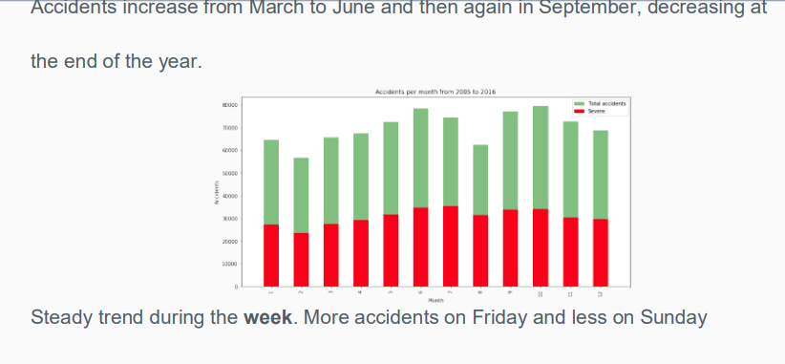
EDA-Seasonality

Slide 7
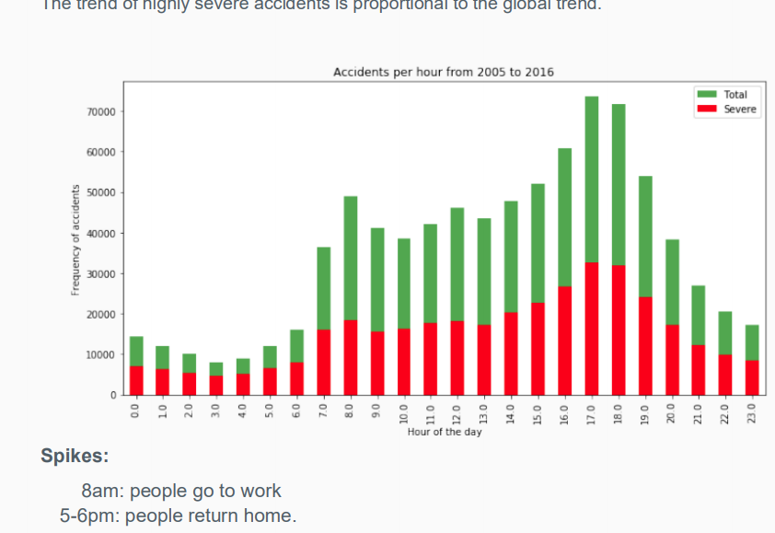
EDA-Seasonality

Slide 8
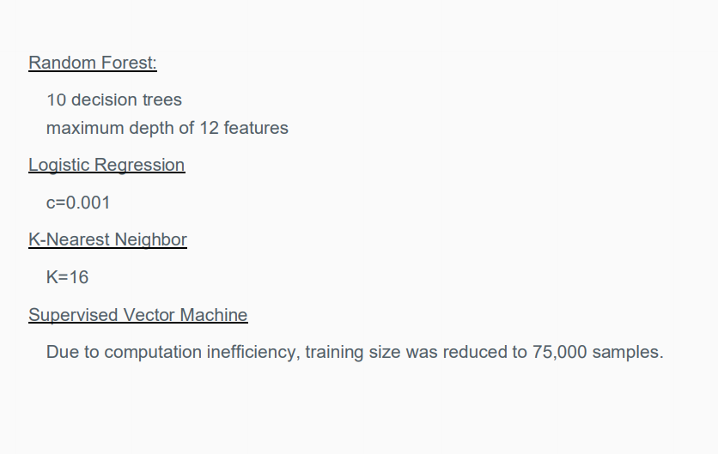
Classification Models

Slide 9
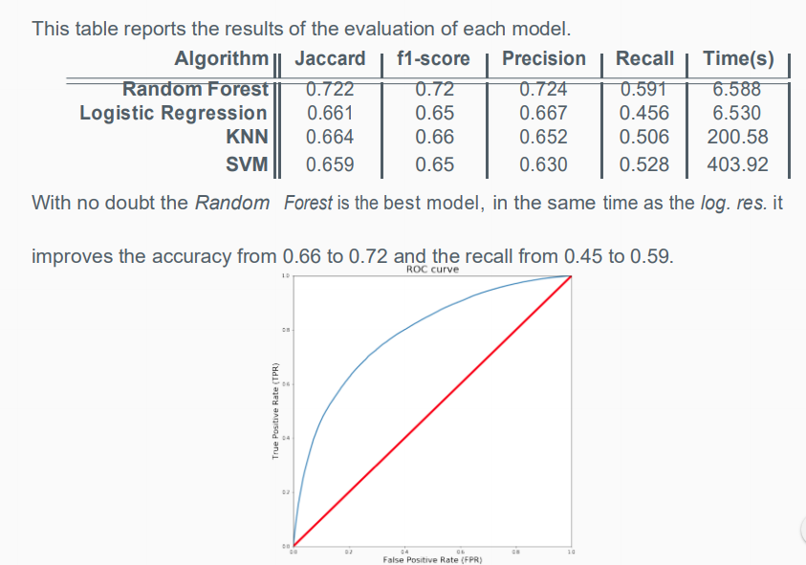
Results

Slide 10
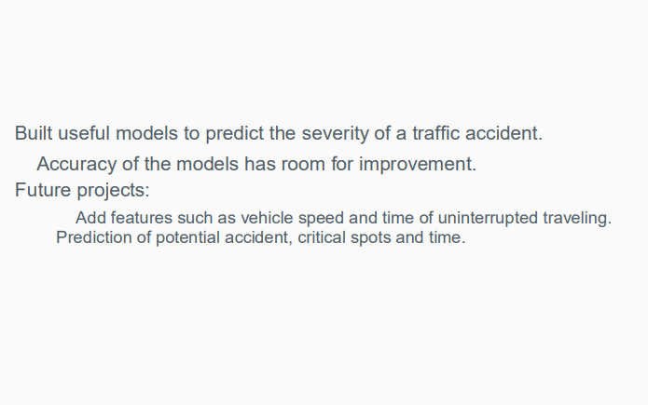
Conclusion

